Slide 1
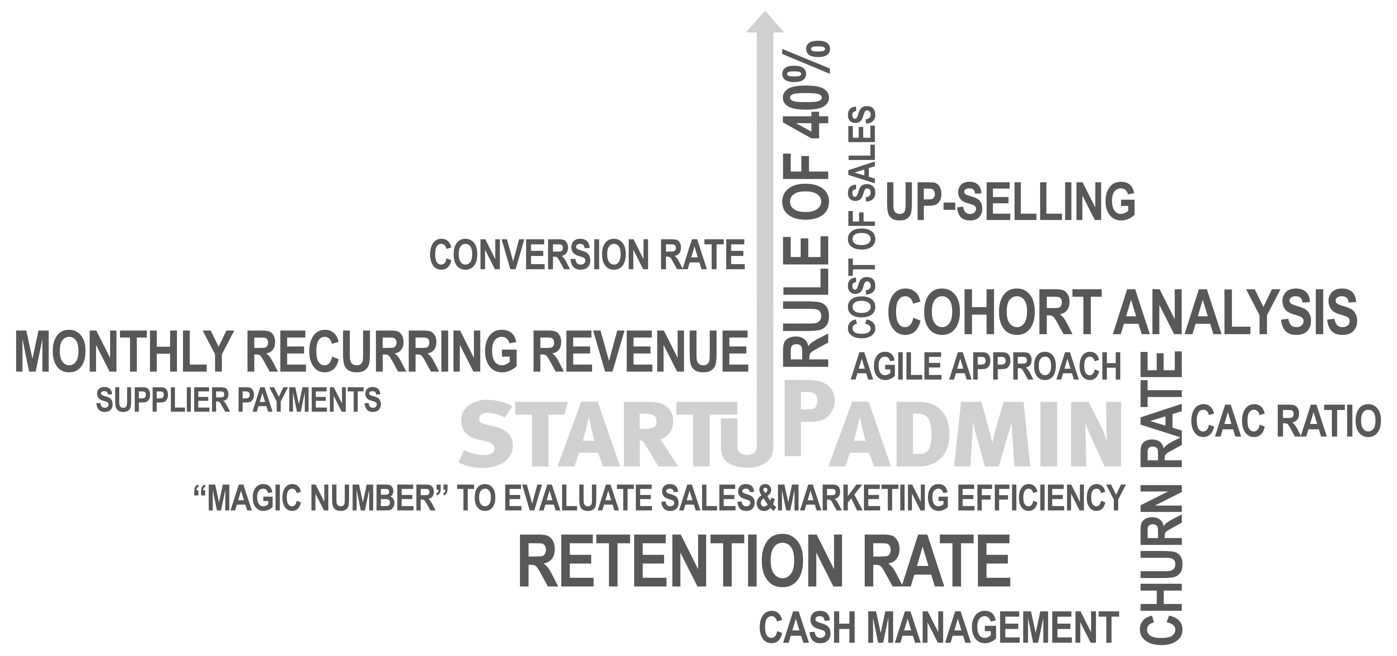
Startupadmin
YOU - do your startup business
WE - do your back office admin
Startupadmin – OUR Contribution
to the European startup ecosystem...
... discharging for the MD
... trustable for the AI
... fit and proper for the VC
SHARED SERVICE CENTER FOR
EUROPEAN STARTUPS
• High-professional monitoring of Scalability
• Tailor-made reporting of your KPIs
• Dedicated CFO on demand
• Reliable compliance of Payroll, Tax and Accounting
FAL-CON MANAGEMENT CONSULTING GmbH
Wollzeile 1-3, Stiege 3, 3.2., 1010 Wien, Austria | t +43 1 5037447 | office@fal-con.eu, www.startupadmin.eu
FAL-CON HOLDING GmbH and all affiliates are independent members of tgs global network limited, an international network of professional business advisors.

